Slide 1
The State of Sakai
Charles Severance, Sakai PMC Chair

Slide 2
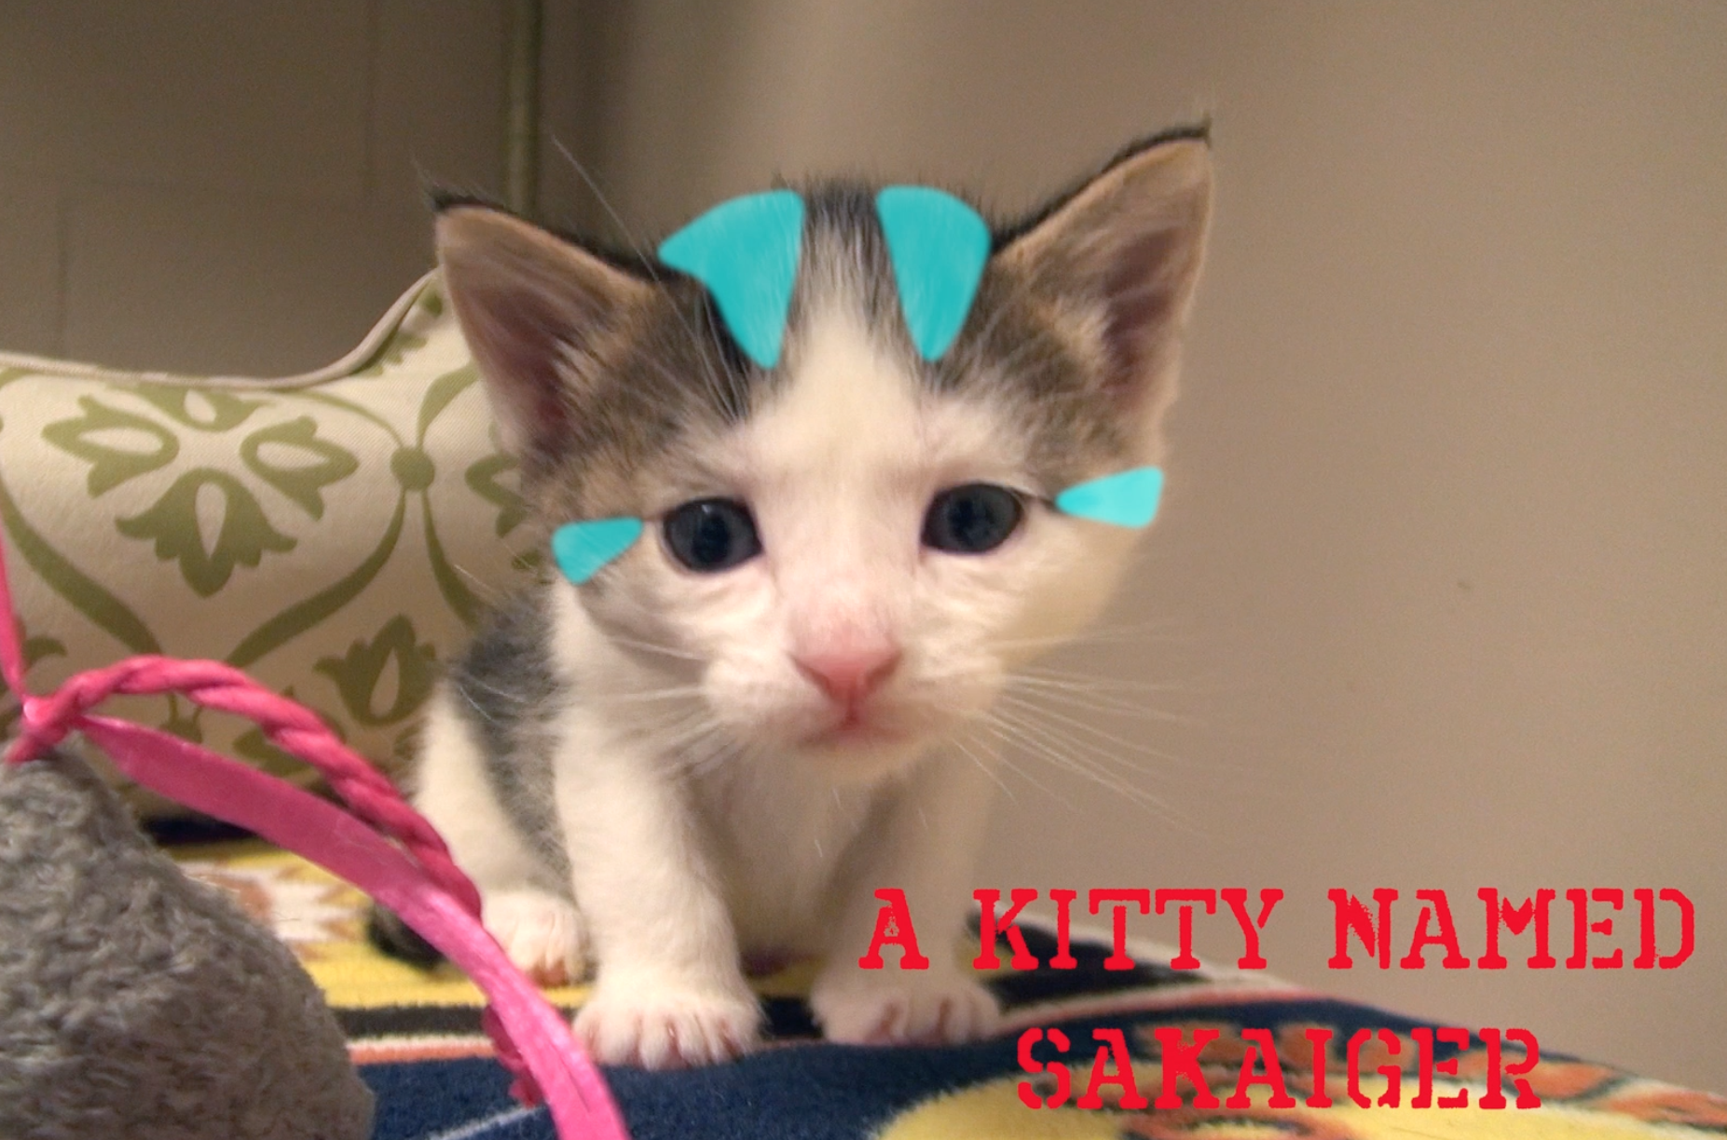

Slide 3


Slide 4
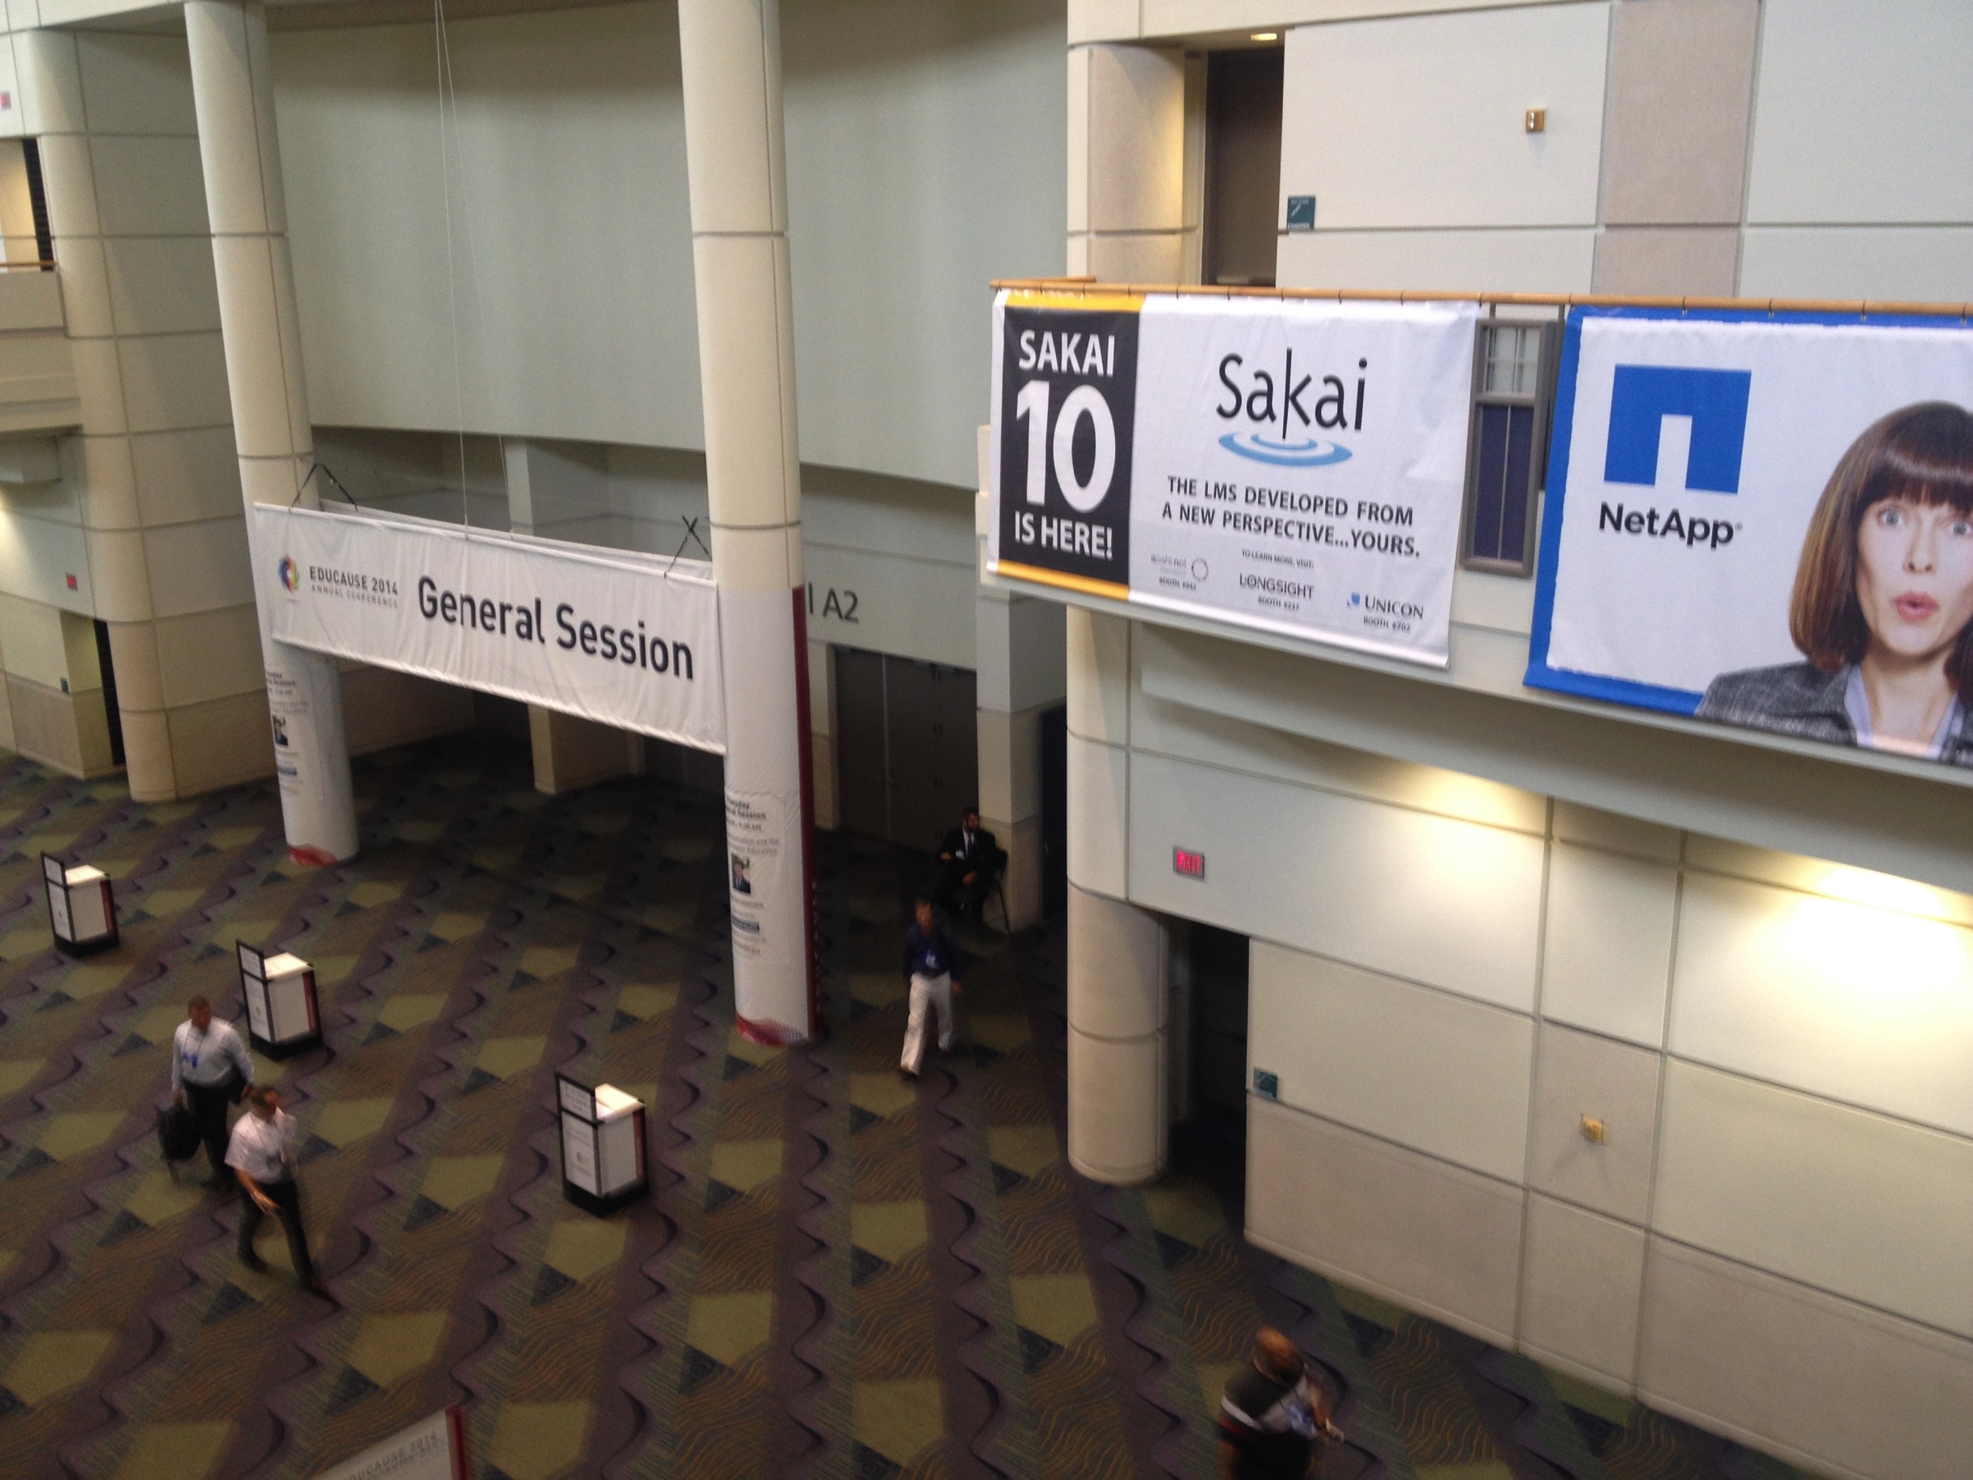

Slide 5

Core Values
Open Source
Open Community
Open Planning / Roadmap
Our "shareholders" are the adopters and users

Slide 6
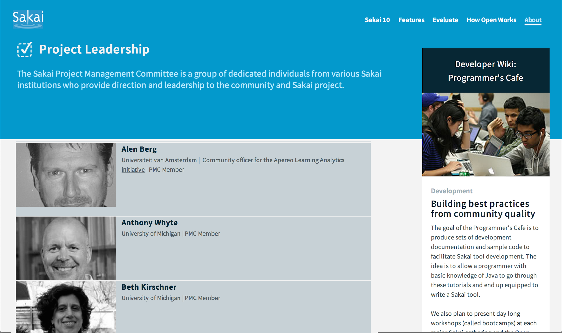

Slide 7
LMS Market
Sakai has never been about market share
5-6% of the US market
8-10% of the international market
Many schools still on old software
Angel
Pre Blackboard 9.0
Commercial competition is intensifying

Slide 8

Leadership in Standards
Leading the way in cross-LMS interoperability
Helped found most of major IMS Standards
Learning Tools Interoperability (IMS LTI)
Common Cartridge (IMS CC)
First to ship most IMS standards
Most recently IMS LTI 2.0 in Sakai 10

Slide 9

A Decade of Innovation
Sakai 2.9 – Summer 2013
Course navigation / Lesson Builder
Sakai 10 – Summer 2014
Improve cloud hosting / Many small UI Improvements
Sakai 11 – Fall 2015
Responsive design / large UI improvements

Slide 10
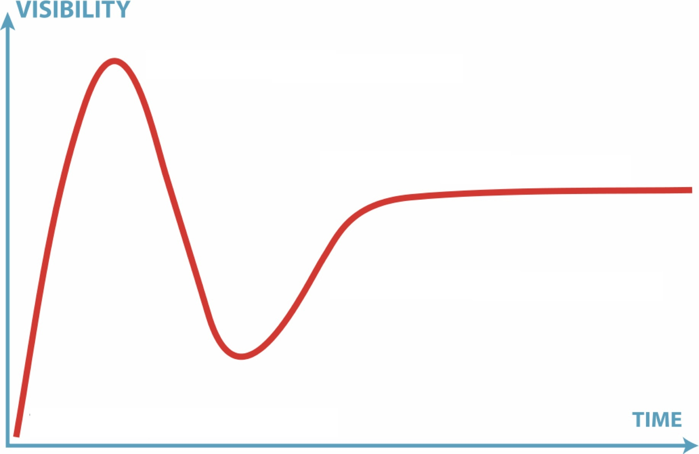

Perception Versus Reality
11
2.9
10
2.6
2.7
2.8
2.5
2.0
1.0
1.5

Slide 11
Peer Grading Assignments
Group Assignments
Help Improvements
Forums "MOOC-like"
Test and Quizzes – All HTML5 recorder
Syllabus Improvements
Improved messaging
Lesson Builder
Peer rubrics
Polls
Rich Text Editor
Audio Record HTML
Accessibility/ARIA
MathML
Grade Book Extra Credit
Drag / Drop Upload

Slide 12
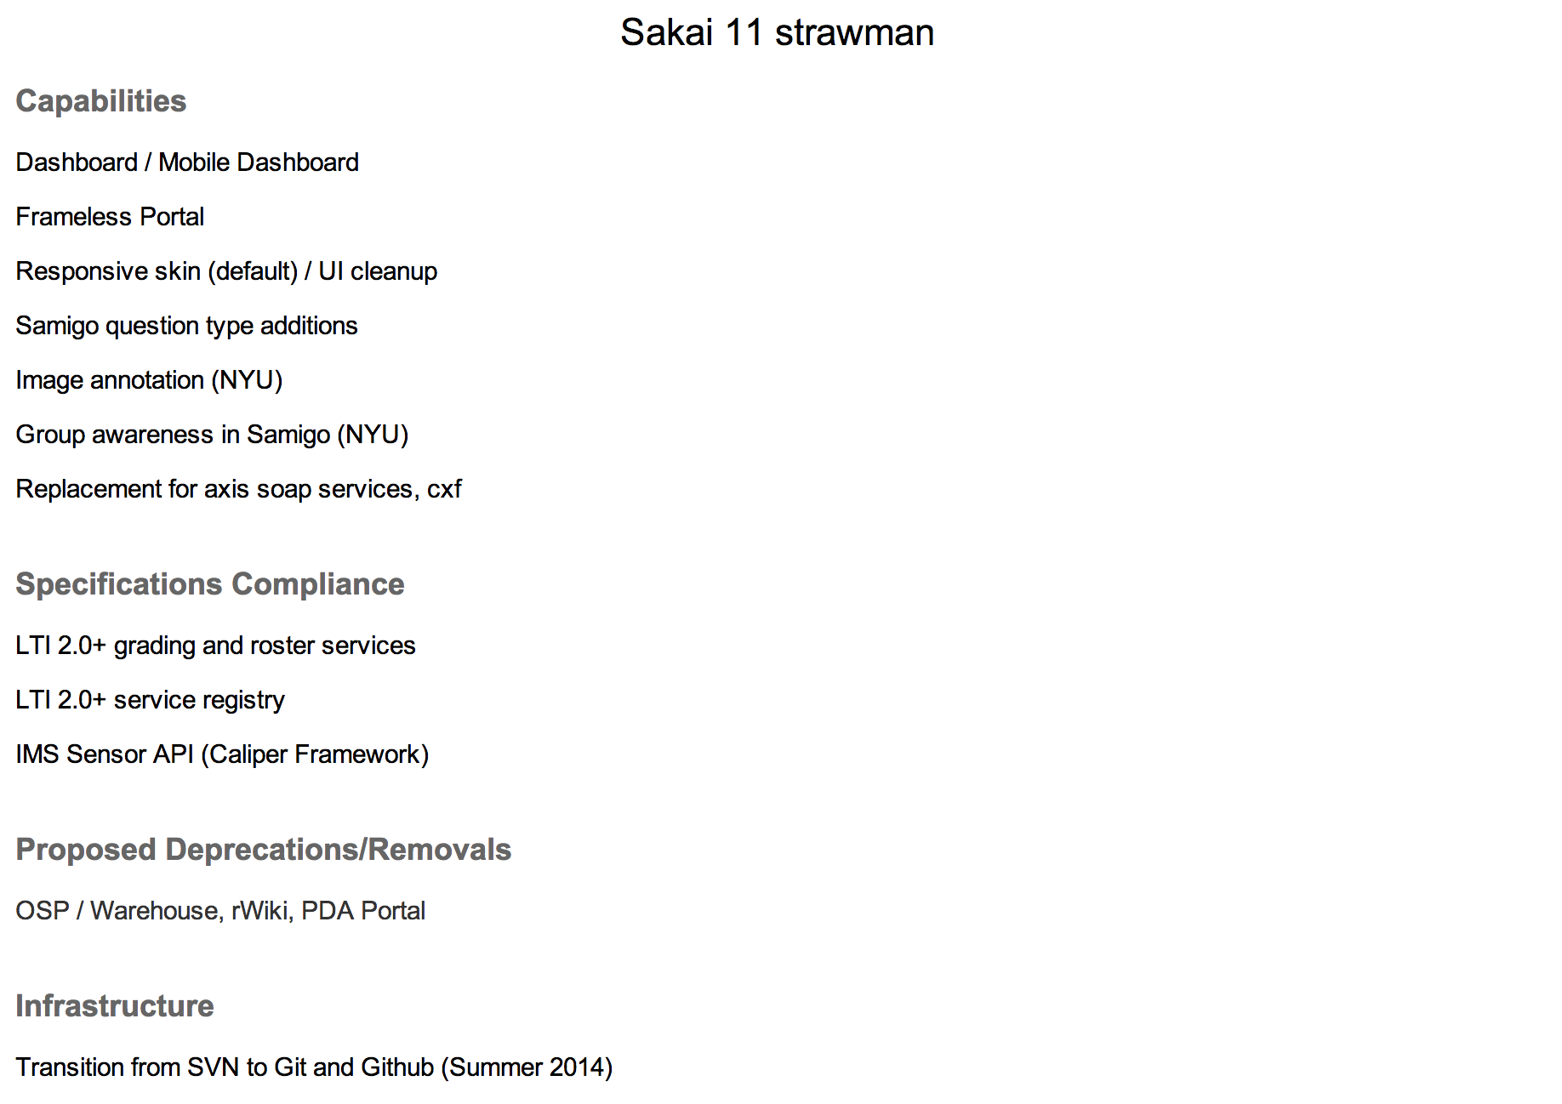
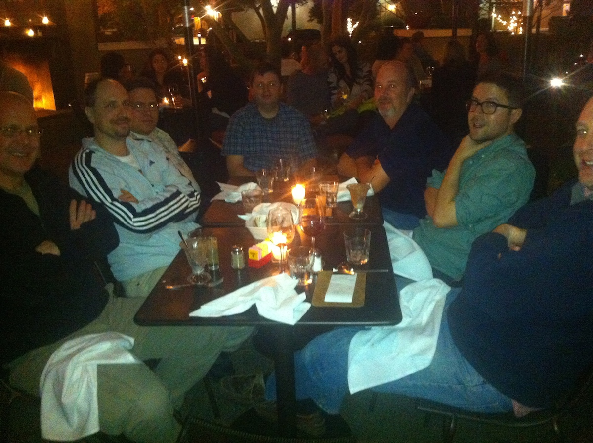
January 2014
https://confluence.sakaiproject.org/display/REL/Sakai+11+straw+man

Slide 13
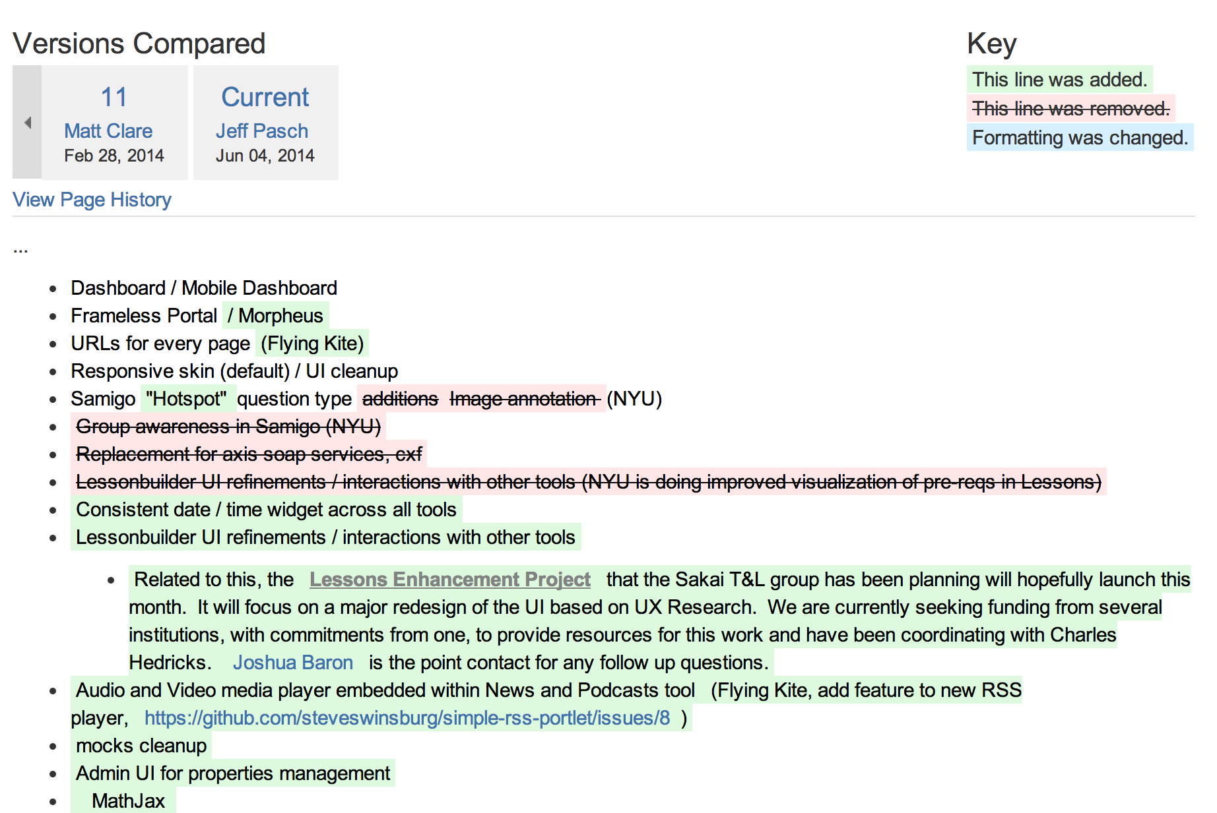
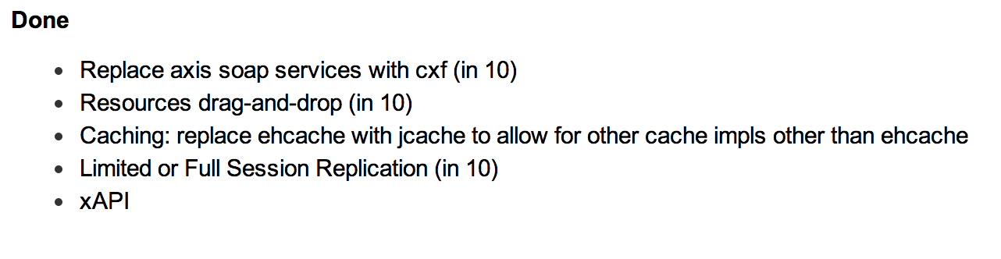
https://confluence.sakaiproject.org/display/REL/Sakai+11+straw+man

Slide 14
Sakai 11 – Significant UI/UX
Morpheus Portal is iframe-free and Responsive
NYU, Marist, Murcia
Grade book UI Redesign
Lessons UI Redesign

Slide 15
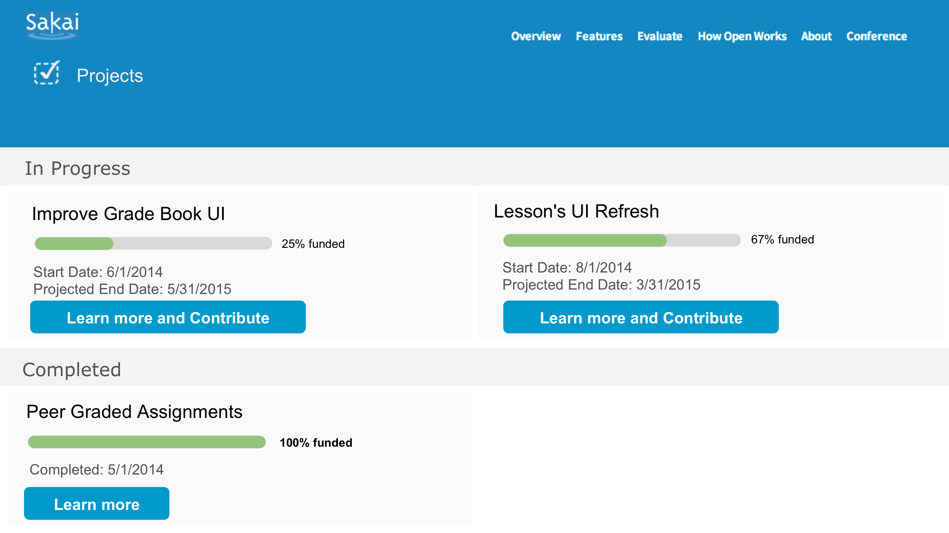
Fund Raising with a Purpose

Slide 16
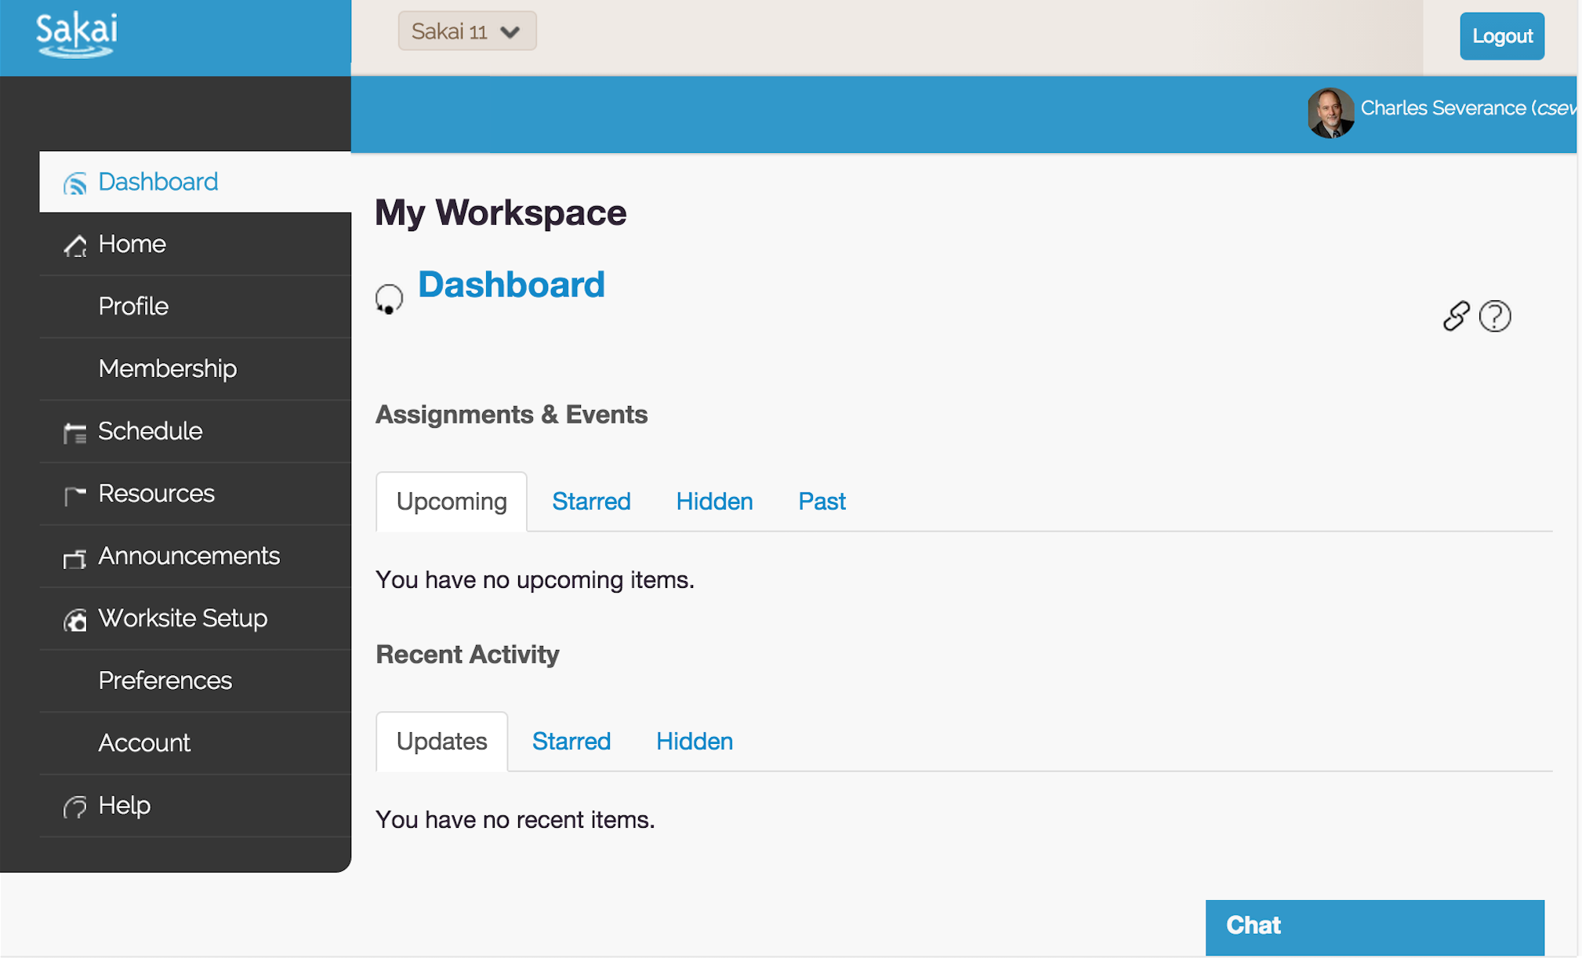

Slide 17
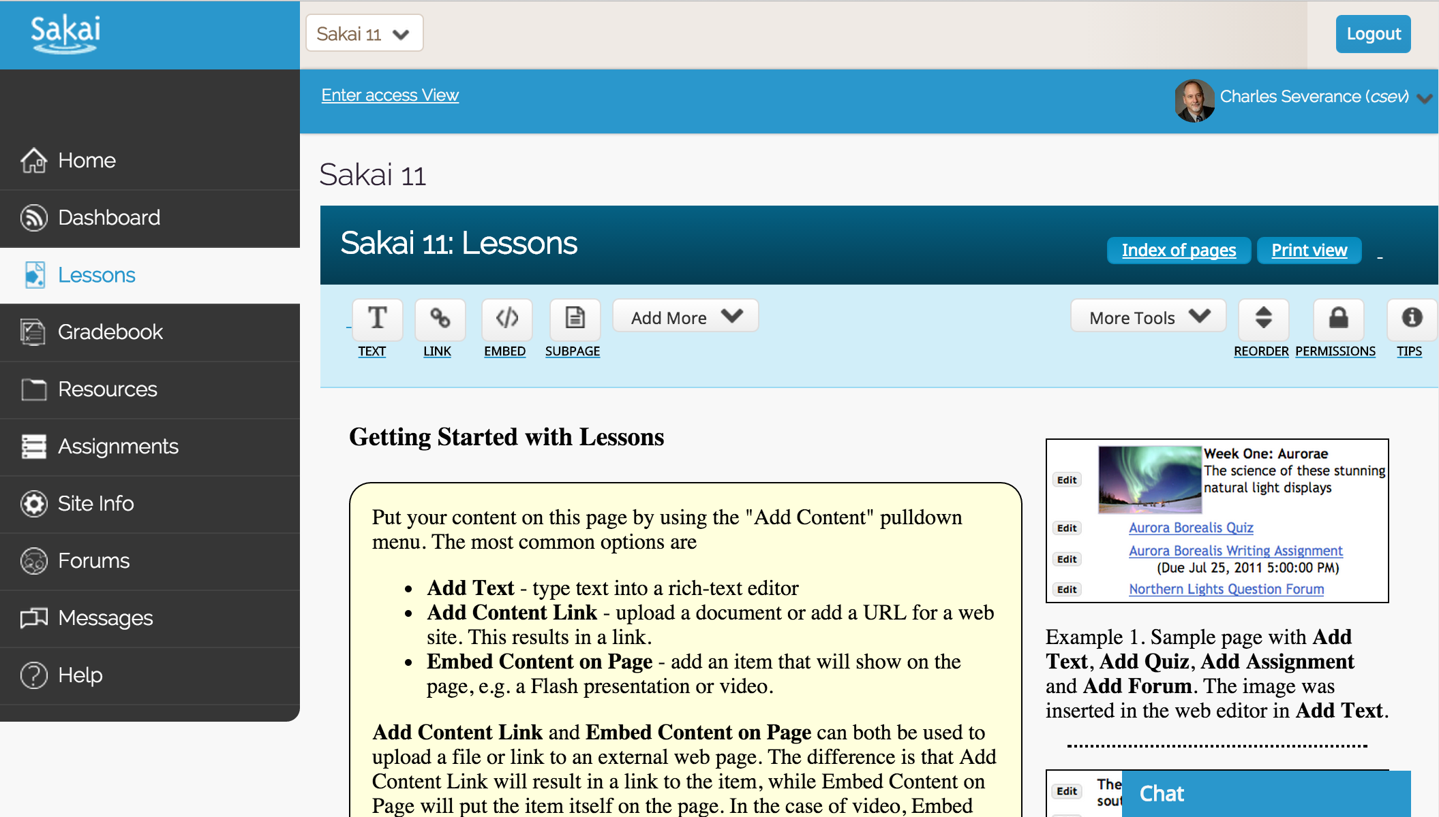

Slide 18
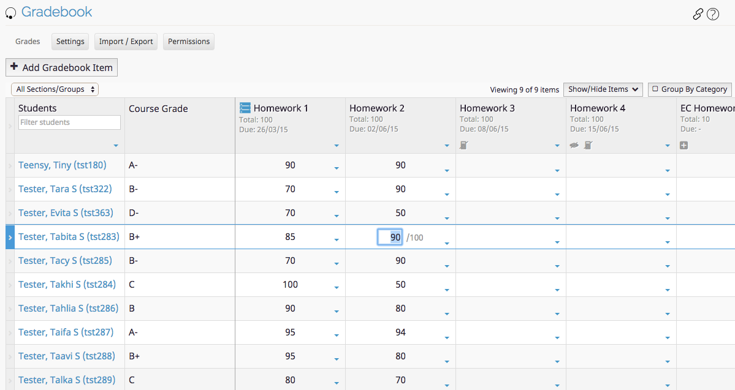

Slide 19
Sakai-11 Schedule
Late June - Sakai 11 branch cut. Code freeze / String freeze .
2015 October - RC01 (lots of testing between now and then is needed. lots of bug fixing too!)
Q4 2015 - Stretch goal - release Sakai 11

Slide 20
Community

Slide 21

Source Code Control

Slide 22
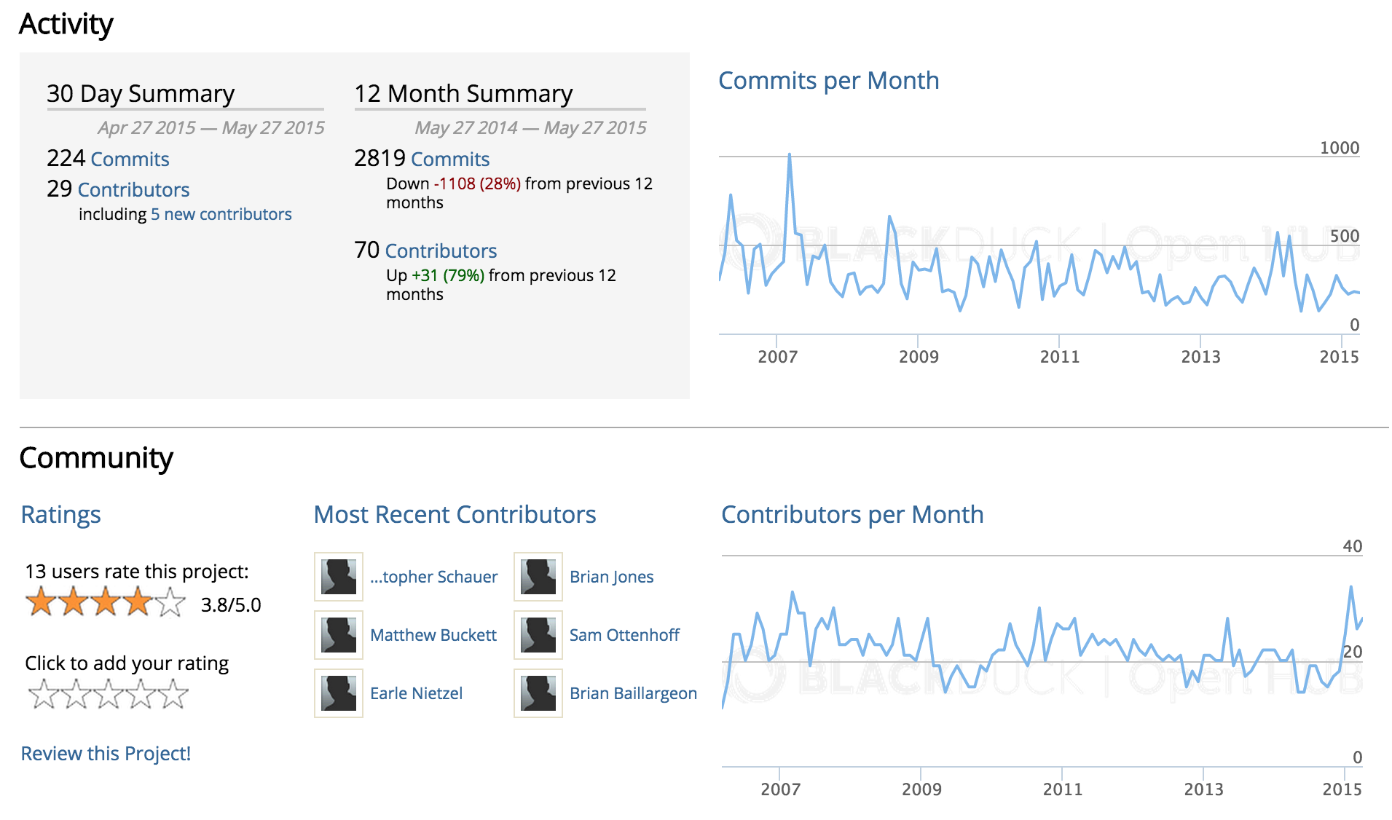
https://www.openhub.net/p/sakai

Slide 23
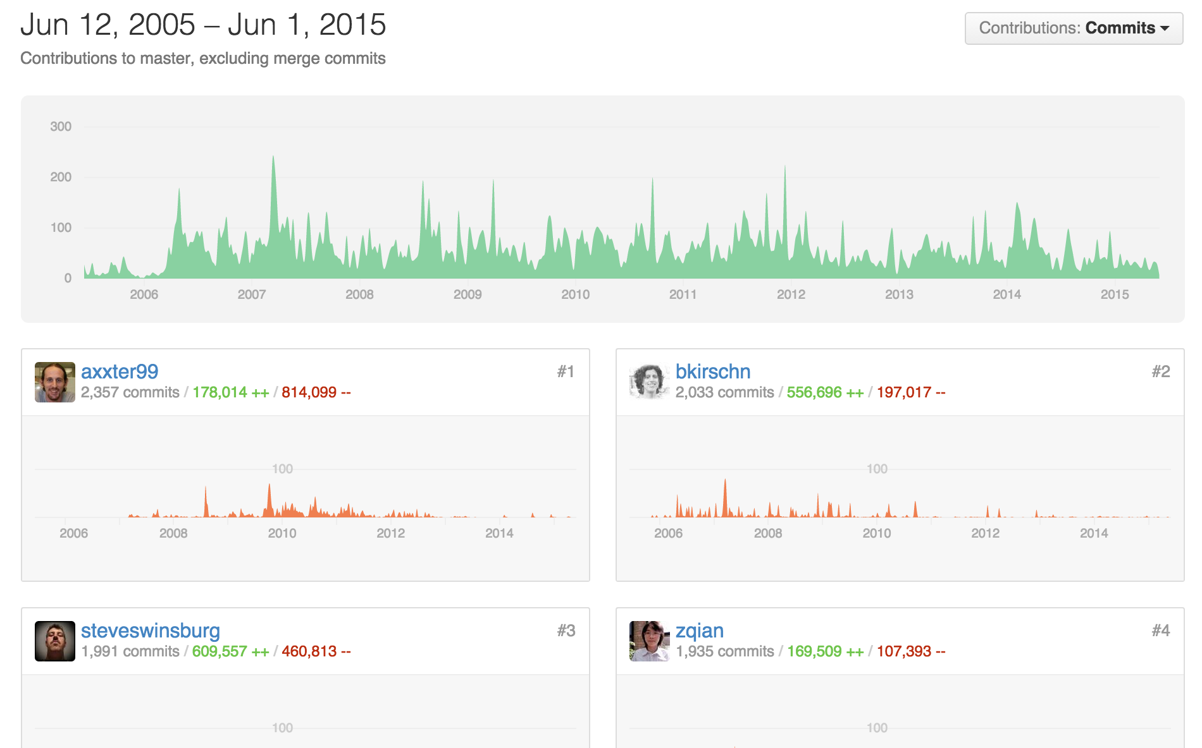
https://github.com/sakaiproject/sakai/graphs/contributors

Slide 24
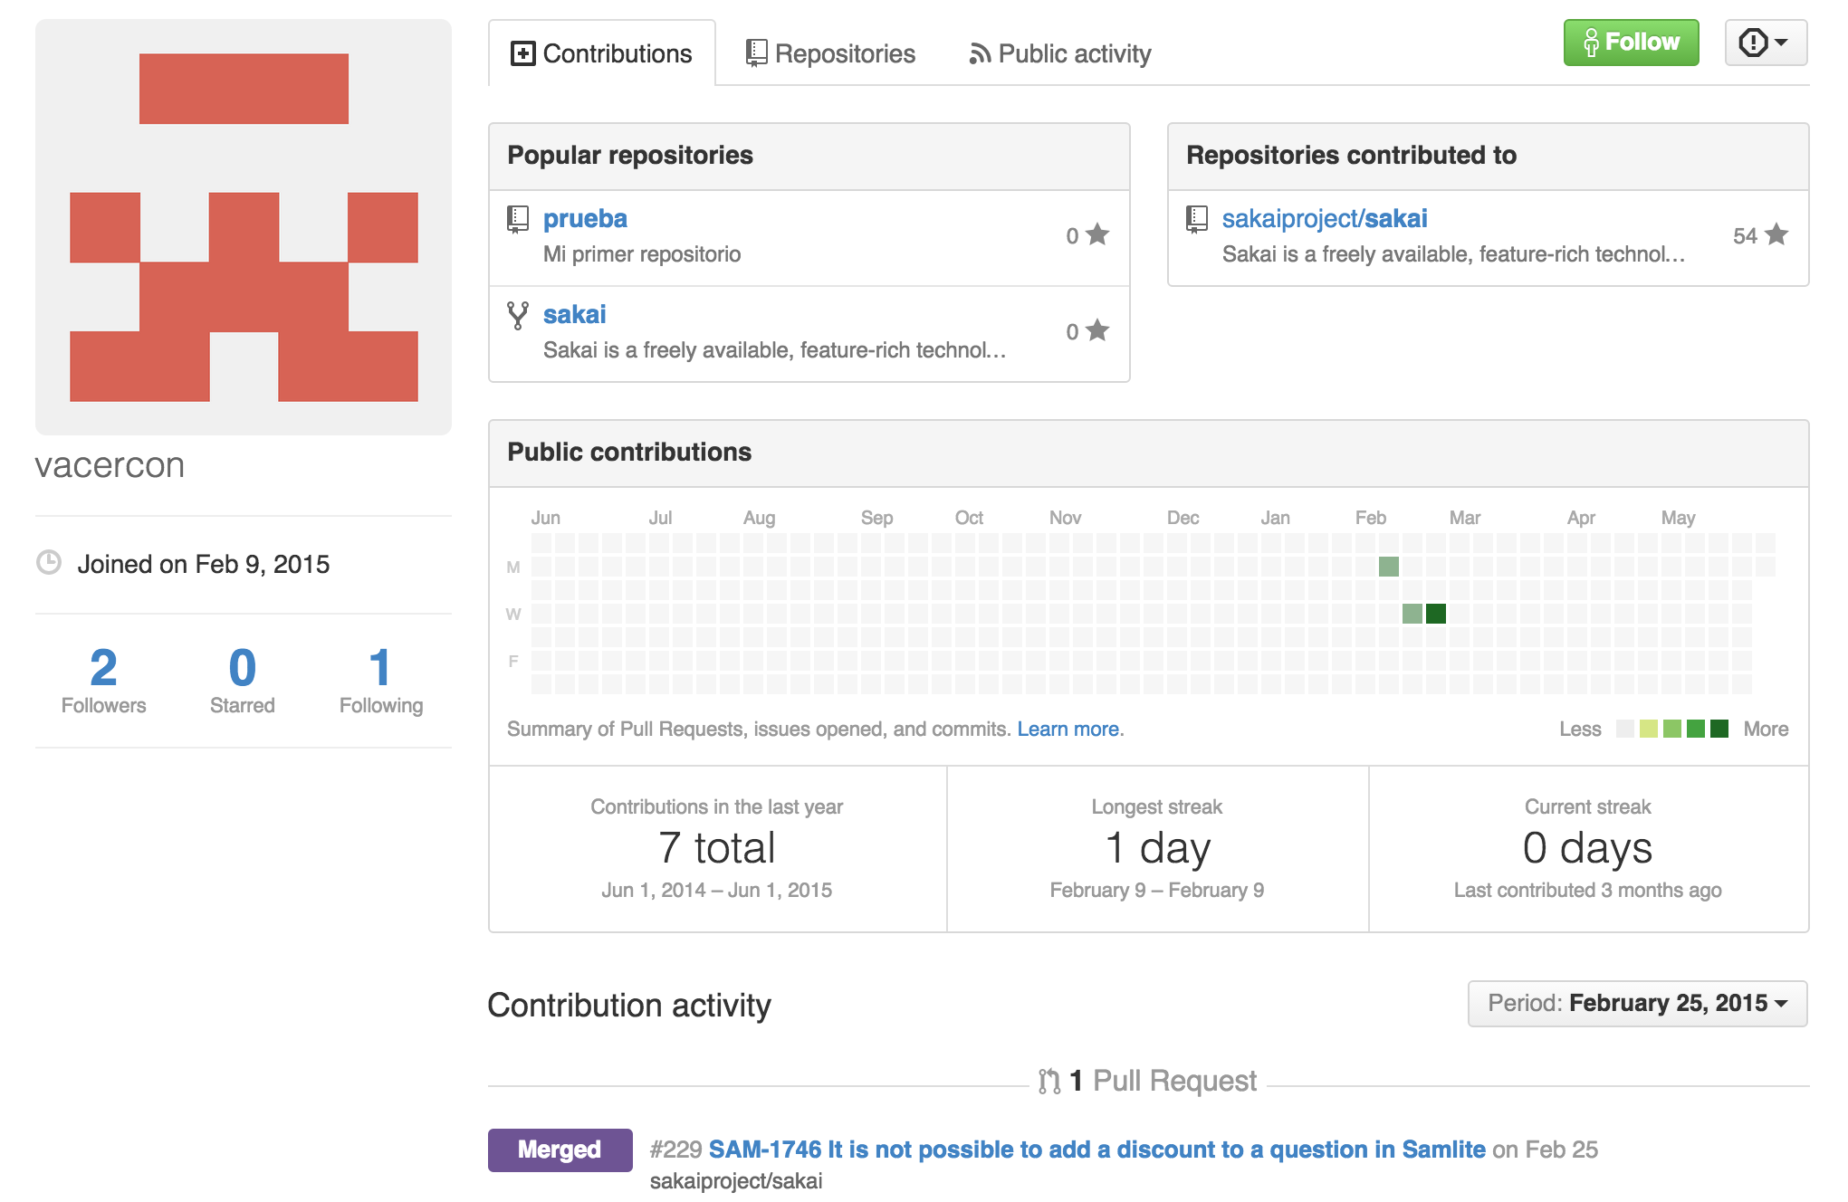
https://github.com/sakaiproject/sakai/graphs/contributors

Slide 25
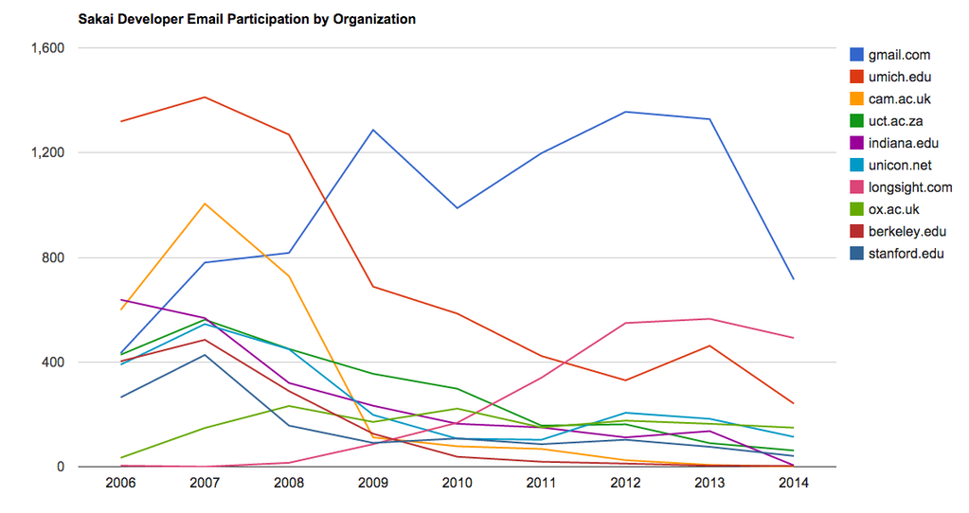

Slide 26



Leadership
Rutgers
Oxford
Cape Town
Notre Dame
Duke
Marist
NYU
Western University
Texas State University
UHUHS
...

Slide 27
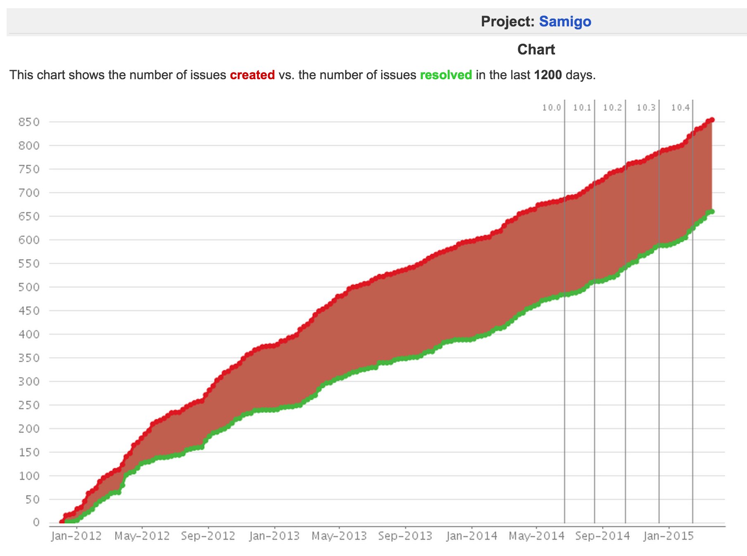

Transitions

Slide 28
Sakai 12 – Dream Big?
12?
11
2.9
10
2.6
2.7
2.8
2.5
2.0
There has never been a better time to dream big in Sakai.
1.0
1.5

Slide 29
Emerging Learning Systems
XERTE – 10:30
Karuta – 11:15
OpenCast – 13:45
Tsugi – www.tsugi.org

Slide 30

D'Arcy Norman's Law of eLearning Tool Convergence
Any eLearning tool, no matter how openly designed, will eventually become indistinguishable from a Learning Management System once a threshold of supported use-cases has been reached.
http://darcynorman.net/2013/02/15/normans-law-of-elearning-tool-convergence/

Slide 31
